Slide 1
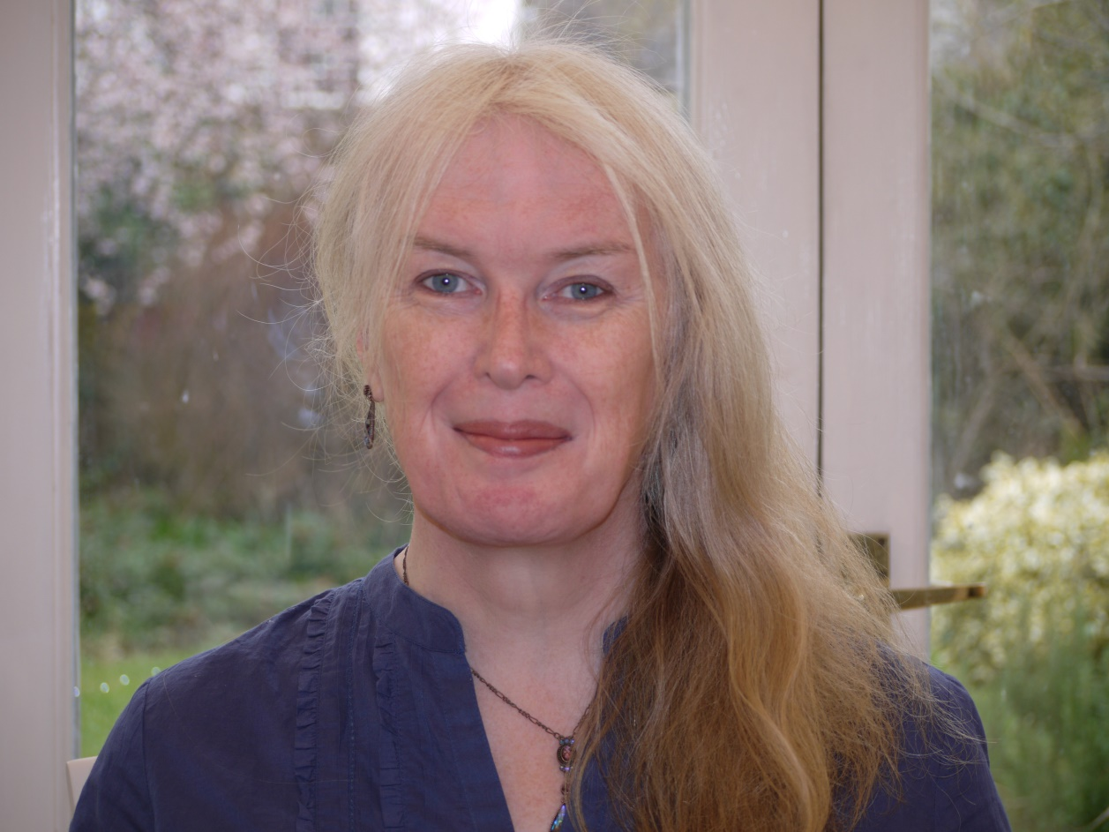
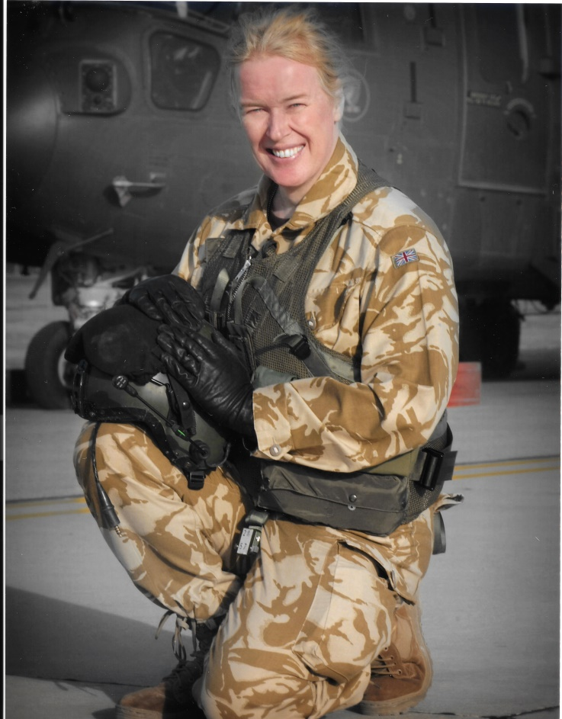
Diversity
Inclusion
Respect

Slide 2
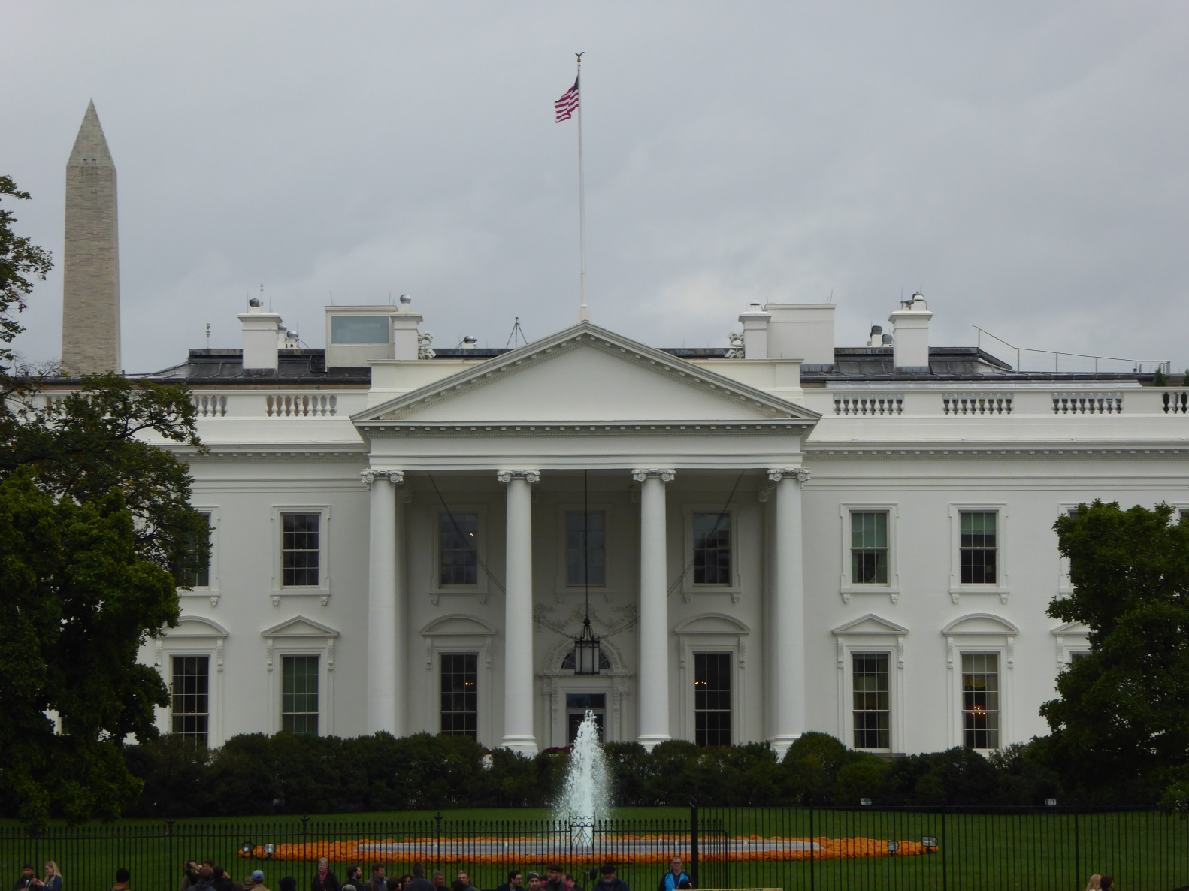
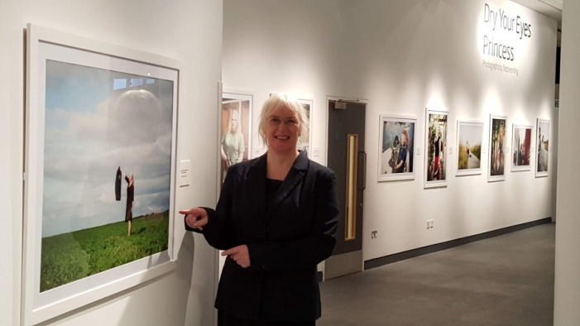
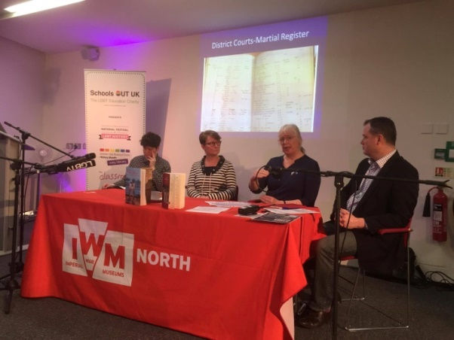
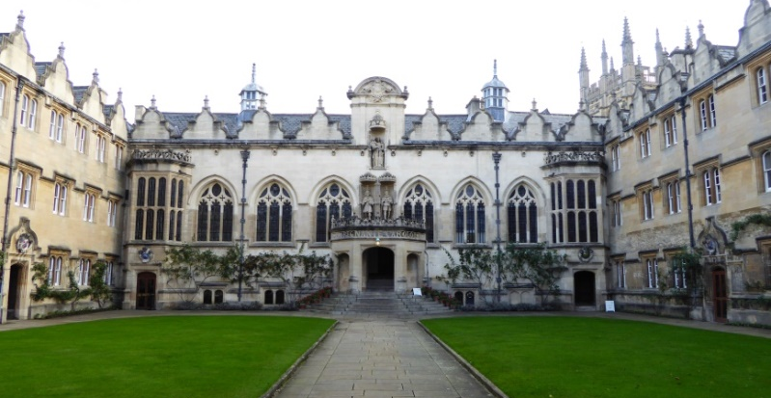

Slide 3
Inclusion Gains
RETENTION
Experience
Skills
Budget
RESPECT
Individual Unit National International
DIVERSE TEAM
Team Cohesion
Individual Ambition
Loyalty
RECRUITMENT
Joined the Modern World

Slide 4
Inclusion Losses

Slide 5
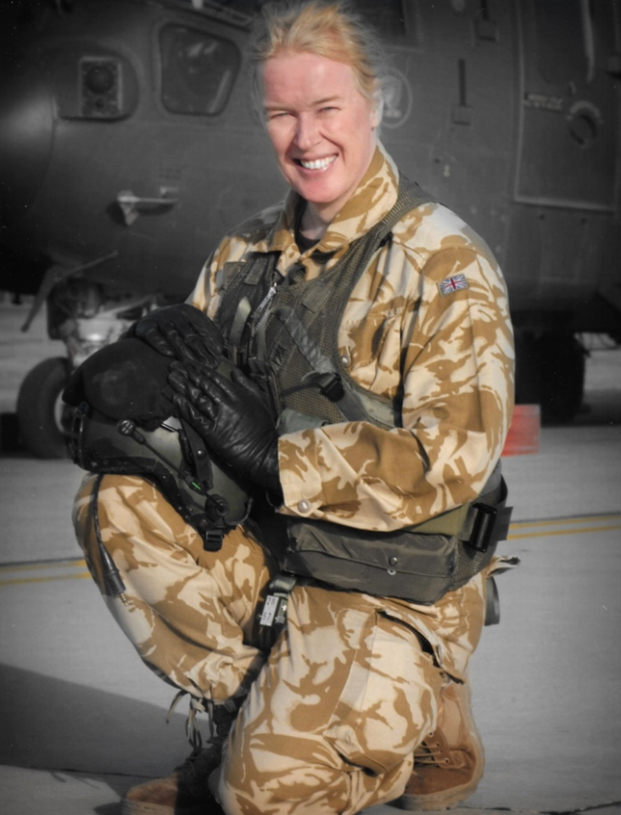
Questions?
Caroline Paige
5th Aug 2016
National Ambulance LGBT Network Conference
Notes:
Intro
Invited to talk about my story
RAF 1980 – 2014
1999 Transitioned became 1st Officer in UK Armed Forces
My story,
Story mine
All different

Slide 6
National Ambulance LGBT Network Conference
5th August 2016
Amex Stadium, Brighton
True Colours, by Caroline Paige:
The inspirational account of the first openly transgender officer in the UK Armed Forces.
Biteback Publishing
Notes:
Intro
Invited to talk about my story
RAF 1980 – 2014
1999 Transitioned became 1st Officer in UK Armed Forces
My story,
Story mine
All different

