Slide 1
The Organisational Management of Mental Health
Darren Humphrey
Dip HE, BSc Hons, RN (MH) Senior Clinician, March on Stress

Slide 2
Scope
Prevalence of common mental health disorders
Suicide and known risk factors
Trauma and its Impact
Vicarious trauma and burnout
Barriers to care
Peer Support and StRaW
Notes:
I hope to cover the following areas today, and I encourage interaction throughout. Whilst the aim today is to identify some of the common presentations you are likely to manage during your work as a volunteer??? I am keen to learn from your past experiences and highlight any of the concerns or indeed lessons you have identified previously.

Slide 3
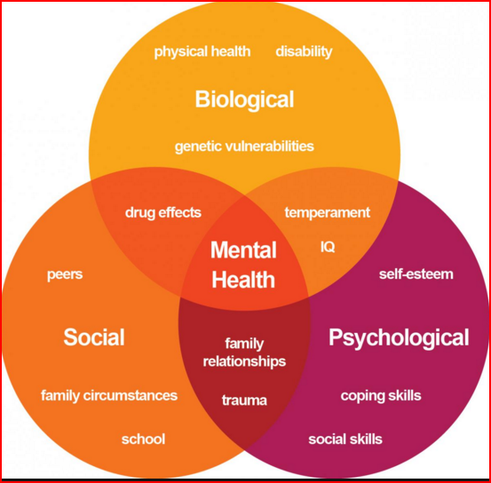
Mental Health
Notes:
This is really highlighting the amount of different factors that impact on a persons mental health. Negative experiences do not directly correlate to poor mental health, but are to be considered when looking at vunerability factors and existing pressures that may be impacting on a persons mental health.

Slide 4
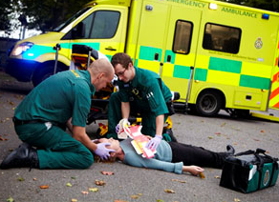

Sources of Stress
Work
Home

Slide 5

Work Life Balance
Notes:
Trying to achieve a healthy work life balance is more challenging than it looks.

Slide 6
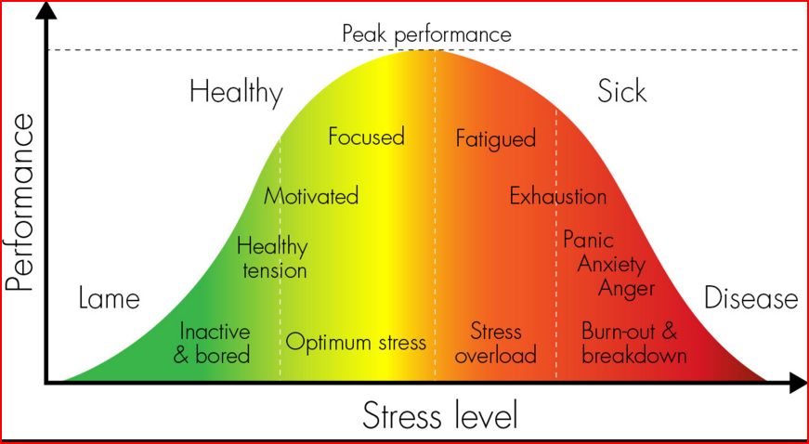
STRESS
Notes:
I am sure most of you would have seen this type of graph before. Its a bell curve depicting the relation between levels of stress and its duration and the impact on performance. As you can see stress is an important factor in performance. If we had no stress then you are either asleep, dead or in one of my presentations. The key is that stress is a healthy norm, that aids performance. However if someone is exposed to high levels of stress over a prolonged period of time fatigue will set in and will eventually lead to increased levels of sickness and burnout. This is when a persons perceived resources have become overwhelmed. A this point mental illness is highly likely without an intervention.

Slide 7
Mental Health Problems are Common!!
7.8% of people meet criteria for Mixed anxiety & depression diagnosis in UK.
4-10% of people in England will experience depression in their lifetime.
Mixed anxiety and depression has been estimated to cause one fifth of days lost from work in Britain.
One adult in six has had a common mental disorder.

Slide 8
What are ‘Common’ Mental Health Disorders
Anxiety
Depression
Adjustment Disorders
Post Traumatic Stress Disorder
Alcohol misuse
(SMD – psychosis, ED, ADHD, ASD)

Slide 9
So……..
Common Mental Health conditions are…common
They affect health and productivity
They are pretty well understood
So….just get on and treat them eh?

Slide 10



Physical Health Treatment?
Back to work
Treatment
Return to good health

Slide 11

Mental Health Treatment?
Recognition
Availability
Loss of esteem
Self stigma
Geography
Loss of confidence
Barriers to care
Trust
Back to work
Treatment
Return to good health
Career fears
Training
Fear of relapse
Time off work
Therapeutic Alliance
Concerns of colleagues

Slide 12
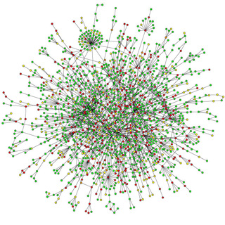

The reality is that MH treatment processes are complex!
Antidepressants
CBT
Sick leave

Slide 13

The Black Dog

Slide 14
The Prevalence of Suicide
  13 People die every day as a result of suicide in the UK
  Highest rates are men aged between 40-50
  It is the leading cause of death amongst young men.
  The rate of suicide amongst men is 3 x that of women
  Suicide rates in women have risen significantly over the last 5 years

Slide 15
Known Risk Factors
Family history of suicide
Family history of child maltreatment
Previous suicide attempt(s)
History of mental disorders, particularly clinical depression
History of alcohol and substance abuse
Feelings of hopelessness
Impulsive or aggressive tendencies
Cultural and religious beliefs
Local epidemics of suicide
Isolation, a feeling of being cut off from other people
Barriers to accessing mental health treatment
Loss (relational, social, work, or financial)
Physical illness
Easy access to lethal methods
Unwillingness to seek help because of the stigma attached to mental illness

Slide 16
Suicide and the LGBT Community
The rate of suicide attempts is 4 times greater for LGB youth and 2 times greater for questioning youth than that of straight youth.
Suicide attempts by LGB youth and questioning youth are 4 to 6 times more likely to result in injury, poisoning, or overdose that requires treatment
40% of transgender adults reported having made a suicide attempt. 92% of these individuals reported having attempted suicide before the age of 25.
LGBT youth who come from highly rejecting families are 8.4 times as likely to have attempted suicide as LGB peers who reported no or low levels of family rejection.

Slide 17
LGBT Suicide Risk Factors
Minority Stress - In the LGBT population, more than 75% of people in a community setting reported suffering verbal harassment
Internalised homophobia also contributes to LGBT suicide risk.
LGB youth who experienced severe family rejection were more than 8 times more likely to report having attempted suicide compared with peers from families with little or no rejection.
LGBT suicide risk factors also include previous suicide attempts, existing psychiatric conditions and other risk factors that can be present for anyone.

Slide 18
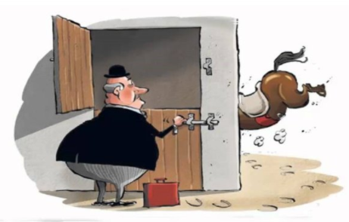

Slide 19
Protective Factors
Known Protective factors against LGBT suicide include:
Family support
Reduced stress
Caring adults
School safety and positivity
Equal rights under the law
Supportive workplaces and communities

Slide 20
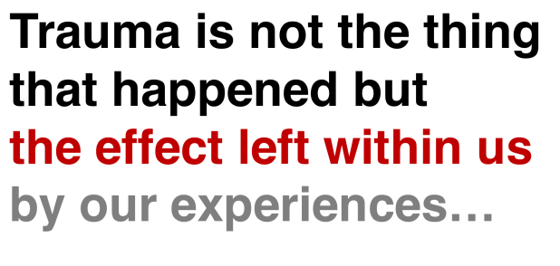
Trauma and its Influence

Slide 21
Trauma and its Influence
Mental Health
Work Related Stress
Home Related Stress
Ability to Function
Trauma Related Stress
Notes:
Trauma does not happen in Isolation.

Slide 22
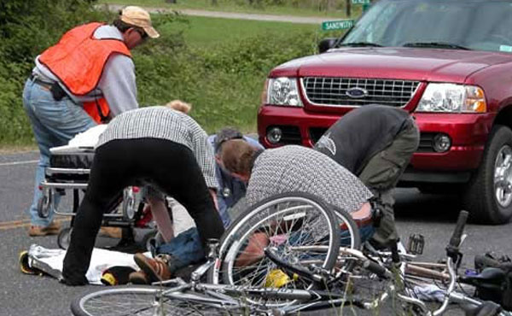

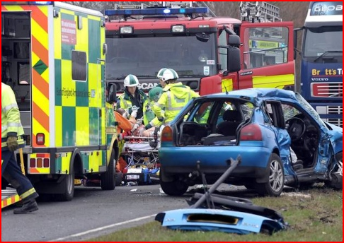
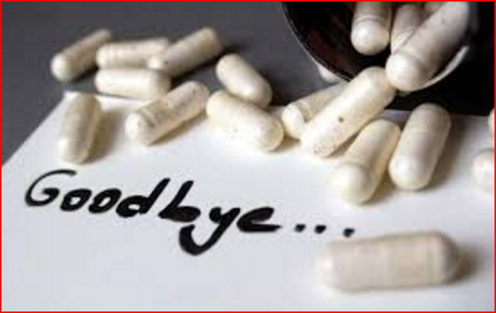
What Constitutes a Traumatic Event?

Slide 23

Potential for a Traumatic Event
Being exposed to:
  Death
  Threatened death
  Actual or threatened serious injury
  Actual or threatened sexual violence
By
  Direct exposure
  Witnessing in person
  Indirectly learning of a close relative/friend’s trauma
  Repeated or extreme indirect exposure to aversive details of the event(s), usually in the course of professional duties

Slide 24
Acute (Post-Traumatic) Stress Disorder (ASD)
Post a traumatic event some people may experience negative emotional and cognitive reactions.
Most ASD symptoms settle within a month or so.
A minority go on to develop Post Traumatic Stress Disorder (PTSD).
Characterised by re-experiencing, avoidance, arousal and changes in mood and thoughts.

Slide 25
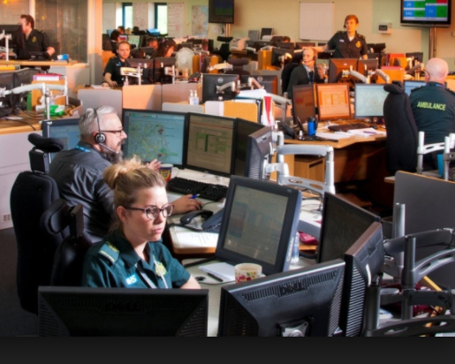
Vicarious Trauma and Burnout
Not considered mental health disorders but commonly used terms
  Vicarious Trauma - poor mental health resulting from listening to traumatized people. May be more likely if the listener has their own mental health difficulties
  Burnout - emotional /physical exhaustion from coping with prolonged pressure. Associated with reduced feelings of personal accomplishment and lack of care for oneself, for others and tasks

Slide 26
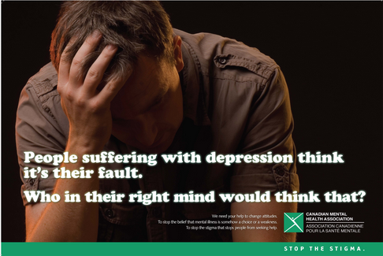
Stigma

Slide 27
History of Stigma (and the military)
WW1
  Cowardice could lead to execution
WW2
  LMF and the RAF (“Lack of moral fibre” (LMF)
  General Patton
  Churchill’s view of military psychiatry
Modern day
  US purple heart
  Security Clearance and MH

Slide 28
Stigma and barriers to care
Gould et al, 2010, JRSM

Slide 29
Help seeking for PTSD
And it’s not just an issue for “stiff upper lip” professions
Woodhead et al, 2010, Soc Sci Med

Slide 30
Learning points….
Work certainly can be good for mental health but it can also be ‘bad’
Common mental health disorders are common and…
Problematically most ‘distressed’ people don’t seek help

Slide 31
So if stigma prevents help seeking….when do people seek mental health care?

Slide 32
Where do people get ‘help’ from?

Slide 33
And where do people get help from “at work”?
Operational Mental Health Needs Evaluation- Afghanistan 2010

Slide 34
Who do people get support from after work?
Greenberg et al, JMH, 2003

Slide 35
Learning points….
Most people do not seek help for MH problems
They tend to wait until the last moment before asking for assistance (Often far too late)
When they do seek help they prefer informal sources over professionals

Slide 36
Prevention
Primary
  Leadership
  Cohesion
  Training (psychoeducation, training for role)
  Screening (enlistment, before deployment, before new role)
Secondary
  Screening (annual, post deployment, higher risk (primary care, padres, welfare))
  Peer support (TRiM and StRaW)
Tertiary

Slide 37
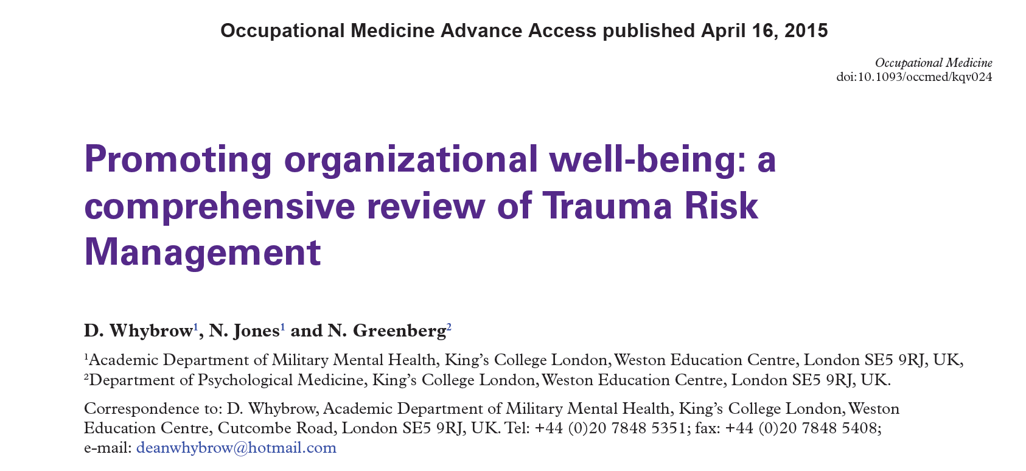
www.kcl.ac.uk/kcmhr under publications

Slide 38
TRiM
TRiM is a peer support system for the early detection of those in psychological distress.
The TRiM model bases itself on keeping employees functioning after traumatic events by providing support and education to those who require it.
It works by training TRiM Practitioners throughout an organisation to spot signs of psychological distress in their colleagues.

Slide 39


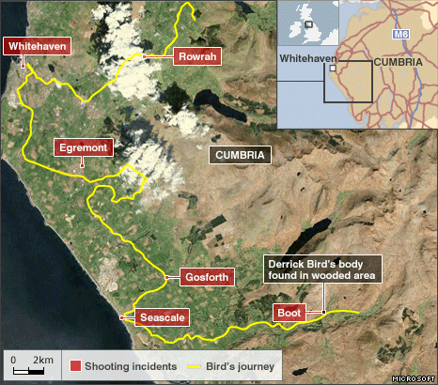
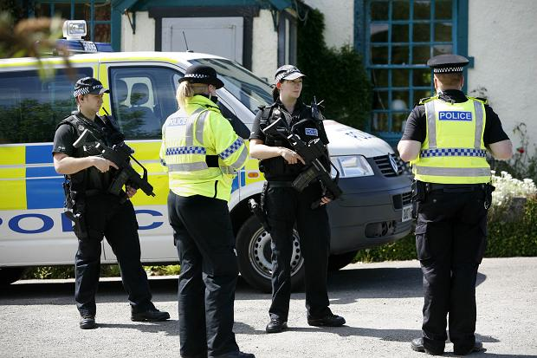
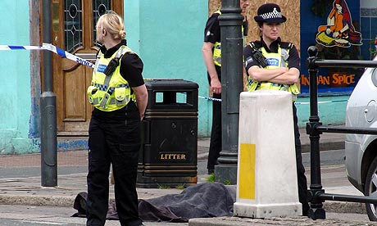
TRiM and Cumbria ‘Derek Bird’ shootings

Slide 40

StRaW
A peer support package designed to improve organisational resilience
Based on good science and best practice
A ‘novel’ approach for non-traumatic stress
Empowers self-reliance whilst encouraging appropriate help-seeking

Slide 41
Conducting StRaW Interviews
Referral from any source (self, colleague, boss, etc)
Active listening
  Informal approach; do not judge not even a little bit
  Be cautious of rumour and hearsay beforehand
Evidence based interview
Score, grade, arrange an action plan

Slide 42
StRaW Risk Assessment Checklist
No | RISK FACTOR
1 | The individual considers that they have little or no control over the way they conduct their work
2 | The individual considers they have recently faced or faces substantial and significant changes or transitions at work
3 | The individual considers that their efforts at work are poorly rewarded
4 | The individual considers that their managers are supportive of their welfare and/or well-being
5 | The individual considers that their colleagues are supportive of their welfare and/or well-being
6 | The individual considers that work-load persistently interferes with their work-life balance/cannot ‘switch-off’ The individual is experiencing substantial life stressors outside of work
7 | The individual is experiencing substantial life stressors outside of work
8 | The individual is experiencing symptoms of distress
9 | The individual is lacking in suitable social support or unable to access it
10 | The individual has been drinking alcohol excessively or has been using negative coping strategies to get by

Slide 43
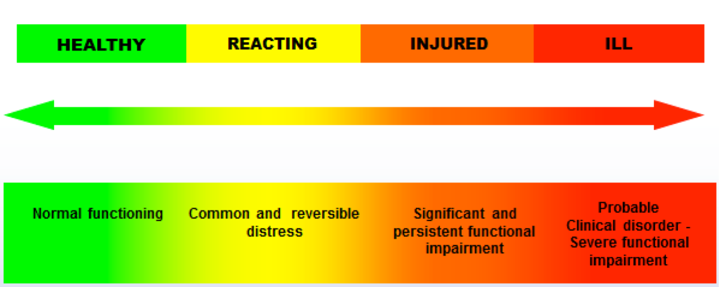
What to make of the information gathered during the StRaW interview?
Notes:
Adapted from USMC COSC stress continuum

Slide 44
Employee Under Stress Decision Pathway
Green Zone (Ready):
Good to go
Advise, reassure
Check-in when possible
Advise to make contact again if required
No Distress or Loss of Function:
No major problems
Possibly concerned about ‘normal’ symptoms
YES
Very low StRaW Score
(0-4)*
Distress or Loss of Function:
Some difficulty relaxing and sleeping
Decreased social/recreational activity
Unusual and excessive fear, worry, or anger
Some negative thoughts about self or future
Difficulty performing normal role
Mild change from normal personality
Yellow Zone (Reacting):
Advise on self-care (including sleep/exercise//leave)
Actively manage work, home & social stressors
Consider mentoring/EAP etc
Plan a review
NO
YES
Low to moderate StRaW score
(5-8)*
Significant Distress or Loss of Function:
Great difficulty in falling asleep or staying asleep
Withdrawal from social or recreational activities
Uncharacteristic outbursts of rage/despair/panic
Great difficulty controlling emotions
Significant negative thoughts about self or future
Loss of usual concern for moral values
Unhelpful coping behavior (e.g. alcohol)
Orange Zone (Injured):
Improve self care (as above)
Talk to manager/HR - consider temporary workplace adjustments
Consider EAP/GP/BUPA
Mentor and support
Plan a review
NO
YES
Moderate to high StRaW score?
(9-13)*
Red Zone (Ill):
Advise/support them to see GP
Consider EAP/BUPA/Occ Health
Ensure ‘treatment compliance’
Mentor back to work if possible
Liaise with HR/boss
NO
Highly Distressed or Loss of Function:
Difficulties lasting for more than several weeks
Failure to cope
Unable to continue as is
Problems that get worse over time
YES
High StRaW score?
(14+)*
*all scores are for guidance only

Slide 45

StRaW Practitioner Skills

Slide 46
Peers as psychological mentors?
Basic Cognitive Behavioural Therapy
Motivational Enhancement Therapy
Problem Solving Therapy
Basic relaxation techniques (e.g. grounding)
How to approach a potentially distressed colleague

Slide 47
Summary
Stigma prevents access to formalised support.
Lots of good reasons to proactively support colleagues at work.
Classic treatment only part of the complex spaghetti bowl.
StRaW
  Increases reach
  Allows for early identification and intervention
  Referral where required
  Based on the strong evidence based TRiM approach

Slide 48

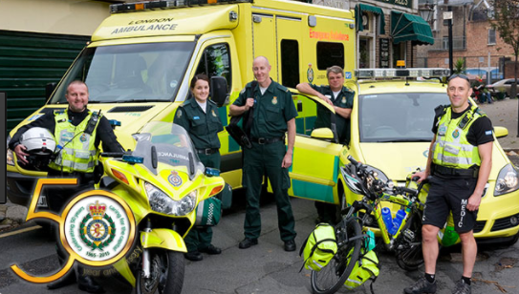
ANY QUESTIONS?

